Slide 1
STATE SPACE ANALYSIS OR STAPE SPACE REPRESENTATION

Slide 2
STATE SPACE REPRESENTATION OR STATE SPACE ANALYSIS
It is the modern approach of analysis and design of Control Systems.
Control system represent in the State Space Representation.
It is a mathematical model of Physical System as a set of input, output and state variables related by first-order differential equations.

Slide 3
STATE VARIABLE AND STATE VECTOR
The smallest set of variables that determines the state of the system are known as State Variable.
It is the vector, which contains the state variables as an elements is called State Vector.

Slide 4
Advantages And Disadvantages of State Space Representation
Analysis is done by considering initial conditions.
More accurate than Transfer Function.
Analysis of Multi Input and Multi Output system are easy.
Gives information about controllability.
It is applicable to all dynamic systems.
Complex Technique.
Many computations are required.

Slide 5
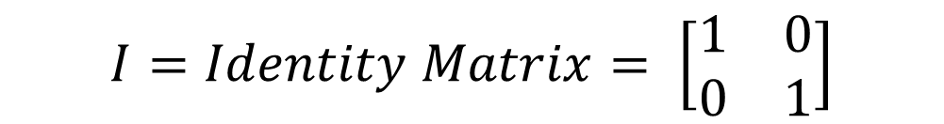
STATE SPACE BASIC FORMULAS
$$Formula of Transfer Function=T\left(s\right)=C {\left[SI −A\right]}^{−1}∗B+D$$
$$I=Identity Matrix= \left[\begin{matrix}1 & 0 \\ 0 & 1\end{matrix}\right]$$
$X^{′}$= $AX+BU (1)$
$Y$= $CX + DU (2)$

Slide 6
CONVERT STATE SPACE
TO
TRANSFER FUNCTION

Slide 7
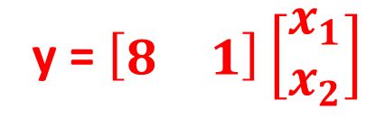
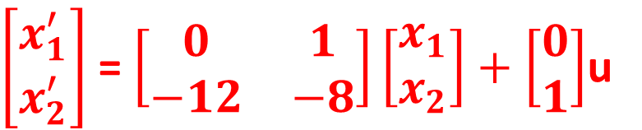
Q: Consider a Single Input Single Output System whose State Variable description is given by
Determine the Transfer Function
$\left[\begin{matrix}x_{1}^{′} \\ x_{2}^{′}\end{matrix}\right]$ = $\left[\begin{matrix}0 & 1 \\ −12 & −8\end{matrix}\right]\left[\begin{matrix}x_{1} \\ x_{2}\end{matrix}\right]+\left[\begin{matrix}0 \\ 1\end{matrix}\right]$u
y = $\left[\begin{matrix}8 & 1\end{matrix}\right]\left[\begin{matrix}x_{1} \\ x_{2}\end{matrix}\right]$

Slide 8
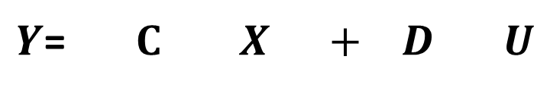
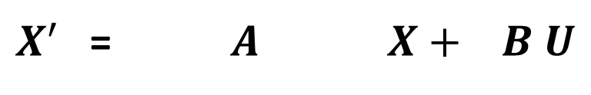
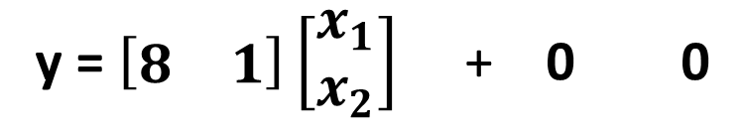
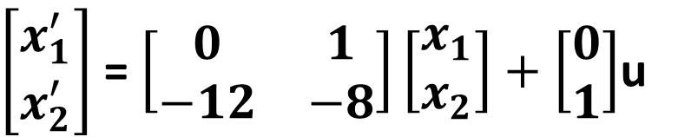
SOLUTION:
General Formula to write State Model
$X^{′}$= $AX+BU (1)$
$Y$ = $CX + DU (2)$
STEP-1: Comparing equation (1) and (2) with given equations
$X^{′}$= $A X+ B U$
$\left[\begin{matrix}x_{1}^{′} \\ x_{2}^{′}\end{matrix}\right]$ = $\left[\begin{matrix}0 & 1 \\ −12 & −8\end{matrix}\right]\left[\begin{matrix}x_{1} \\ x_{2}\end{matrix}\right]+\left[\begin{matrix}0 \\ 1\end{matrix}\right]$u
$Y$= $C X + D U$
y = $\left[\begin{matrix}8 & 1\end{matrix}\right]\left[\begin{matrix}x_{1} \\ x_{2}\end{matrix}\right]$ + 0 0

Slide 9

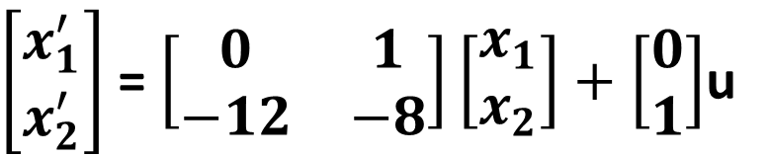
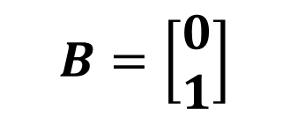
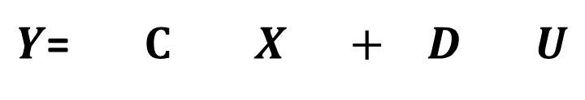
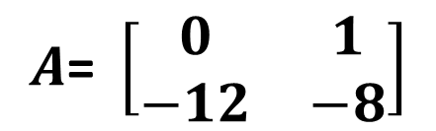
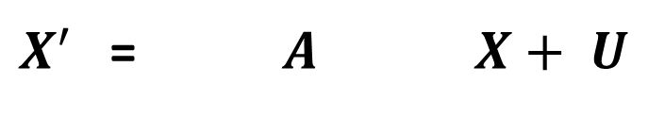
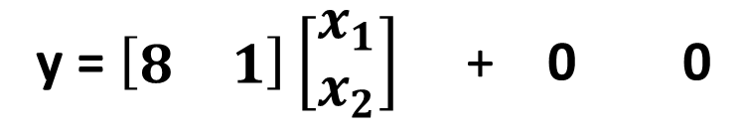

$X^{′}$= $A X+ U$
$\left[\begin{matrix}x_{1}^{′} \\ x_{2}^{′}\end{matrix}\right]$ = $\left[\begin{matrix}0 & 1 \\ −12 & −8\end{matrix}\right]\left[\begin{matrix}x_{1} \\ x_{2}\end{matrix}\right]+\left[\begin{matrix}0 \\ 1\end{matrix}\right]$u
$Y$= $C X + D U$
y = $\left[\begin{matrix}8 & 1\end{matrix}\right]\left[\begin{matrix}x_{1} \\ x_{2}\end{matrix}\right]$ + 0 0
STEP-2: Calculate the values of A, B, C and D
$$A\text{= }\left[\begin{matrix}0 & 1 \\ −12 & −8\end{matrix}\right]$$
$$C=\left[\begin{matrix}8 & 1\end{matrix}\right]$$
$$B=\left[\begin{matrix}0 \\ 1\end{matrix}\right]$$
$$D=0$$

Slide 10

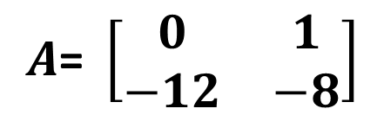


STEP-3: Use the Formula of Transfer Function
$$A\text{= }\left[\begin{matrix}0 & 1 \\ −12 & −8\end{matrix}\right]$$
$$T\left(s\right)=C {\left[SI −A\right]}^{−1}∗B+D (A)$$
$$B=\left[\begin{matrix}0 \\ 1\end{matrix}\right]$$
$$D=0$$
$$C=\left[\begin{matrix}8 & 1\end{matrix}\right]$$
$\left[SI −A\right]=S$ $\left[\begin{matrix}1 & 0 \\ 0 & 1\end{matrix}\right]$ - $\left[\begin{matrix}0 & 1 \\ −12 & −8\end{matrix}\right]$ $=$ $\left[\begin{matrix}S & 0 \\ 0 & S\end{matrix}\right]$ - $\left[\begin{matrix}0 & 1 \\ −12 & −8\end{matrix}\right]= \left[\begin{matrix}S & −1 \\ 12 & S+8\end{matrix}\right]$
${\left[SI −A\right]}^{−1}=\frac{Adj\left[SI −A\right]}{Det (SI−A)} (B)$
$$\left|SI−A\right|=\left|\begin{matrix}S & −1 \\ 12 & S+8\end{matrix}\right|=\left(S\right)∗\left(S+8\right)−\left(−1\right)\left(12\right)= S^{2}+8S+12$$

Slide 11
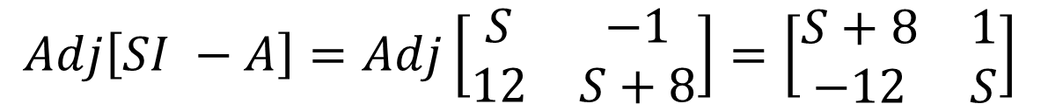

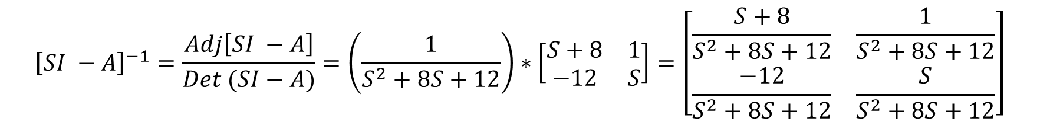
$Adjoint of 2 by 2 Matrix= \left[\begin{matrix}a & b \\ c & d\end{matrix}\right]$ $= \left[\begin{matrix}d & −b \\ −c & a\end{matrix}\right]$
$$Adj\left[SI −A\right]=Adj\left[\begin{matrix}S & −1 \\ 12 & S+8\end{matrix}\right]=\left[\begin{matrix}S+8 & 1 \\ −12 & S\end{matrix}\right]$$
$$Put Values in eq (B)$$
$${\left[SI −A\right]}^{−1}=\frac{Adj\left[SI −A\right]}{Det (SI−A)}=\left(\frac{1}{S^{2}+8S+12}\right)∗\left[\begin{matrix}S+8 & 1 \\ −12 & S\end{matrix}\right]=\left[\begin{matrix}\frac{S+8}{S^{2}+8S+12} & \frac{1}{S^{2}+8S+12} \\ \frac{−12}{S^{2}+8S+12} & \frac{S}{S^{2}+8S+12}\end{matrix}\right]$$

Slide 12
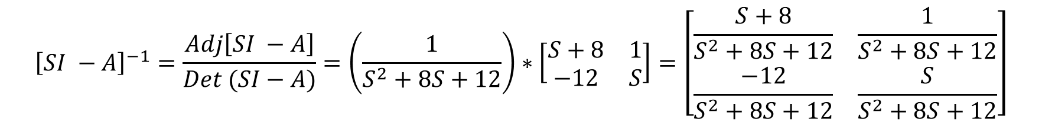
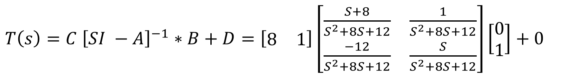
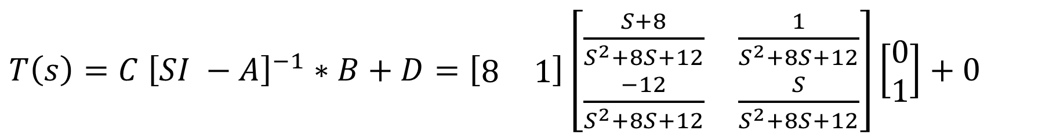
$${\left[SI −A\right]}^{−1}=\frac{Adj\left[SI −A\right]}{Det (SI−A)}=\left(\frac{1}{S^{2}+8S+12}\right)∗\left[\begin{matrix}S+8 & 1 \\ −12 & S\end{matrix}\right]=\left[\begin{matrix}\frac{S+8}{S^{2}+8S+12} & \frac{1}{S^{2}+8S+12} \\ \frac{−12}{S^{2}+8S+12} & \frac{S}{S^{2}+8S+12}\end{matrix}\right]$$
$$Put Values in eq \left(A\right), to calculate the TF$$
$T\left(s\right)=C {\left[SI −A\right]}^{−1}∗B+D=\left[\begin{matrix}8 & 1\end{matrix}\right]\left[\begin{matrix}\frac{S+8}{S^{2}+8S+12} & \frac{1}{S^{2}+8S+12} \\ \frac{−12}{S^{2}+8S+12} & \frac{S}{S^{2}+8S+12}\end{matrix}\right]\left[\begin{matrix}0 \\ 1\end{matrix}\right]+0$
$T\left(s\right)=C {\left[SI −A\right]}^{−1}∗B+D=\left[\begin{matrix}8 & 1\end{matrix}\right]\left[\begin{matrix}\frac{S+8}{S^{2}+8S+12} & \frac{1}{S^{2}+8S+12} \\ \frac{−12}{S^{2}+8S+12} & \frac{S}{S^{2}+8S+12}\end{matrix}\right]\left[\begin{matrix}0 \\ 1\end{matrix}\right]+0$

Slide 13
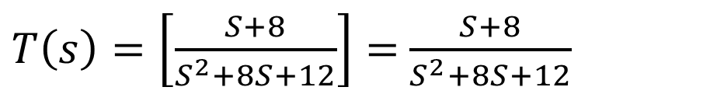
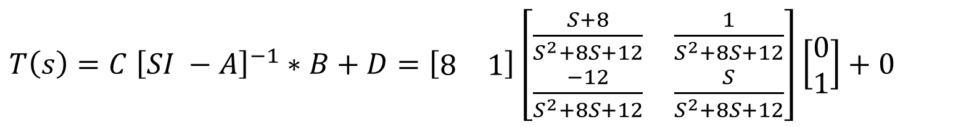
$T\left(s\right)=C {\left[SI −A\right]}^{−1}∗B+D=\left[\begin{matrix}8 & 1\end{matrix}\right]\left[\begin{matrix}\frac{S+8}{S^{2}+8S+12} & \frac{1}{S^{2}+8S+12} \\ \frac{−12}{S^{2}+8S+12} & \frac{S}{S^{2}+8S+12}\end{matrix}\right]\left[\begin{matrix}0 \\ 1\end{matrix}\right]+0$
>> syms s
>> A = [8 1];
>> B = [((s+8)/(s^2+8*s+12)) ((1)/(s^2+8*s+12)); ((-12)/(s^2+8*s+12)) ((s)/(s^2+8*s+12))];
>> C = [0;1];
>> D = A*B*C
$T\left(s\right)=\left[\frac{S+8}{S^{2}+8S+12}\right]=$ $\frac{S+8}{S^{2}+8S+12}$
>> A=[0 1;-12 -8]; >> B =[0;1]; >> C = [8 1]; >> D = 0; >> [n,d]=ss2tf(A,B,C,D); >> mySys_tf=tf(n,d)

Slide 14
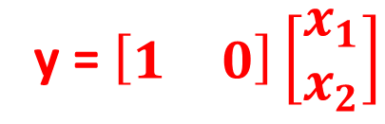
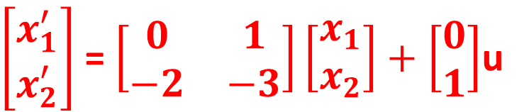
Q: Consider a Single Input Single Output System whose State Variable description is given by
Determine the Transfer Function
$\left[\begin{matrix}x_{1}^{′} \\ x_{2}^{′}\end{matrix}\right]$ = $\left[\begin{matrix}0 & 1 \\ −2 & −3\end{matrix}\right]\left[\begin{matrix}x_{1} \\ x_{2}\end{matrix}\right]+\left[\begin{matrix}0 \\ 1\end{matrix}\right]$u
y = $\left[\begin{matrix}1 & 0\end{matrix}\right]\left[\begin{matrix}x_{1} \\ x_{2}\end{matrix}\right]$

Slide 15
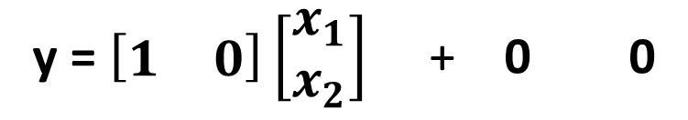
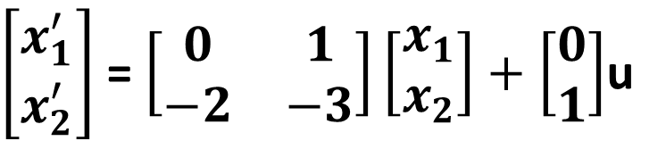
SOLUTION:
General Formula to write State Model
$X^{′}$= $AX+BU (1)$
$Y$ = $CX + DU (2)$
STEP-1: Comparing equation (1) and (2) with given equations
$X^{′}$= $A X+ B U$
$\left[\begin{matrix}x_{1}^{′} \\ x_{2}^{′}\end{matrix}\right]$ = $\left[\begin{matrix}0 & 1 \\ −2 & −3\end{matrix}\right]\left[\begin{matrix}x_{1} \\ x_{2}\end{matrix}\right]+\left[\begin{matrix}0 \\ 1\end{matrix}\right]$u
$Y$= $C X + D U$
y = $\left[\begin{matrix}1 & 0\end{matrix}\right]\left[\begin{matrix}x_{1} \\ x_{2}\end{matrix}\right]$ + 0 0

Slide 16

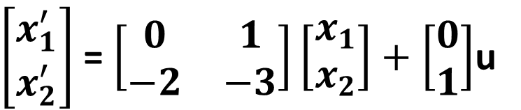
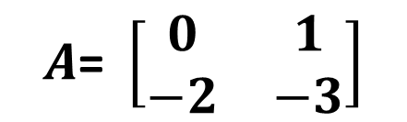
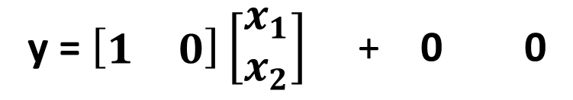
$X^{′}$= $A X+ U$
$\left[\begin{matrix}x_{1}^{′} \\ x_{2}^{′}\end{matrix}\right]$ = $\left[\begin{matrix}0 & 1 \\ −2 & −3\end{matrix}\right]\left[\begin{matrix}x_{1} \\ x_{2}\end{matrix}\right]+\left[\begin{matrix}0 \\ 1\end{matrix}\right]$u
$Y$= $C X + D U$
y = $\left[\begin{matrix}1 & 0\end{matrix}\right]\left[\begin{matrix}x_{1} \\ x_{2}\end{matrix}\right]$ + 0 0
STEP-2: Calculate the values of A, B, C and D
$$A\text{= }\left[\begin{matrix}0 & 1 \\ −2 & −3\end{matrix}\right]$$
$$C=\left[\begin{matrix}1 & 0\end{matrix}\right]$$
$$B=\left[\begin{matrix}0 \\ 1\end{matrix}\right]$$
$$D=0$$

Slide 17
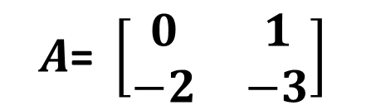

$$A\text{= }\left[\begin{matrix}0 & 1 \\ −2 & −3\end{matrix}\right]$$
STEP-3: Use the Formula of Transfer Function
$$T\left(s\right)=C {\left[SI −A\right]}^{−1}∗B+D (A)$$
$$B=\left[\begin{matrix}0 \\ 1\end{matrix}\right]$$
$$D=0$$
$$C=\left[\begin{matrix}1 & 0\end{matrix}\right]$$
$\left[SI −A\right]=S$ $\left[\begin{matrix}1 & 0 \\ 0 & 1\end{matrix}\right]$ - $\left[\begin{matrix}0 & 1 \\ −2 & −3\end{matrix}\right]$ $=$ $\left[\begin{matrix}S & 0 \\ 0 & S\end{matrix}\right]$ - $\left[\begin{matrix}0 & 1 \\ −2 & −3\end{matrix}\right]= \left[\begin{matrix}S & −1 \\ 2 & S+3\end{matrix}\right]$
${\left[SI −A\right]}^{−1}=\frac{Adj\left[SI −A\right]}{Det (SI−A)} (B)$
$$\left|SI−A\right|=\left|\begin{matrix}S & −1 \\ 2 & S+3\end{matrix}\right|=\left(S\right)∗\left(S+3\right)−\left(−1\right)\left(2\right)= S^{2}+3S+2$$

Slide 18
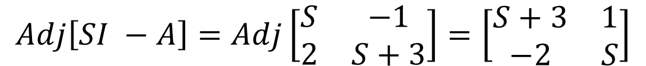
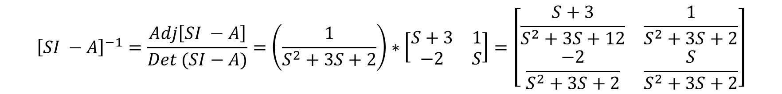
$Adjoint of 2 by 2 Matrix= \left[\begin{matrix}a & b \\ c & d\end{matrix}\right]$ $= \left[\begin{matrix}d & −b \\ −c & a\end{matrix}\right]$
$$Adj\left[SI −A\right]=Adj\left[\begin{matrix}S & −1 \\ 2 & S+3\end{matrix}\right]=\left[\begin{matrix}S+3 & 1 \\ −2 & S\end{matrix}\right]$$
$$Put Values in eq (B)$$
$${\left[SI −A\right]}^{−1}=\frac{Adj\left[SI −A\right]}{Det (SI−A)}=\left(\frac{1}{S^{2}+3S+2}\right)∗\left[\begin{matrix}S+3 & 1 \\ −2 & S\end{matrix}\right]=\left[\begin{matrix}\frac{S+3}{S^{2}+3S+12} & \frac{1}{S^{2}+3S+2} \\ \frac{−2}{S^{2}+3S+2} & \frac{S}{S^{2}+3S+2}\end{matrix}\right]$$

Slide 19
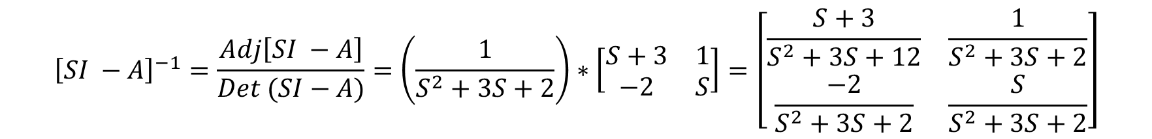
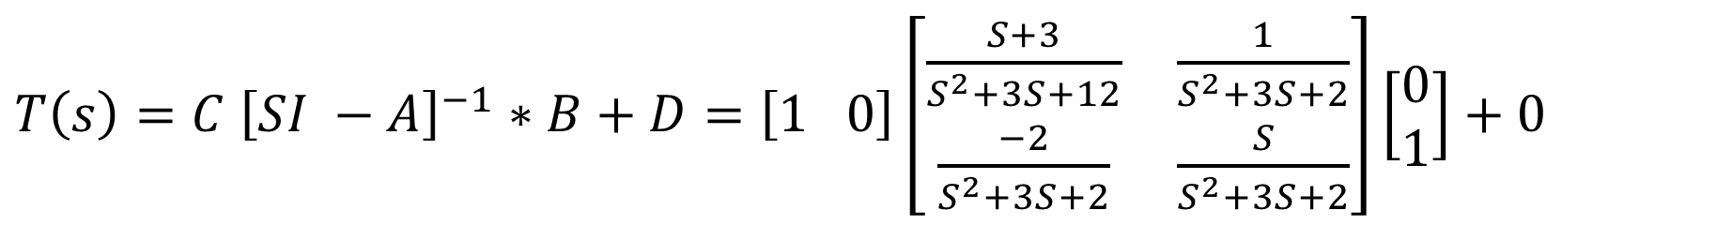
$${\left[SI −A\right]}^{−1}=\frac{Adj\left[SI −A\right]}{Det (SI−A)}=\left(\frac{1}{S^{2}+3S+2}\right)∗\left[\begin{matrix}S+3 & 1 \\ −2 & S\end{matrix}\right]=\left[\begin{matrix}\frac{S+3}{S^{2}+3S+12} & \frac{1}{S^{2}+3S+2} \\ \frac{−2}{S^{2}+3S+2} & \frac{S}{S^{2}+3S+2}\end{matrix}\right]$$
$$Put Values in eq \left(A\right), to calculate the TF$$
$T\left(s\right)=C {\left[SI −A\right]}^{−1}∗B+D=\left[1 0\right]\left[\begin{matrix}\frac{S+3}{S^{2}+3S+12} & \frac{1}{S^{2}+3S+2} \\ \frac{−2}{S^{2}+3S+2} & \frac{S}{S^{2}+3S+2}\end{matrix}\right]\left[\begin{matrix}0 \\ 1\end{matrix}\right]+0$
$T\left(s\right) =\frac{1}{(S+1)(S+2)}$ = $\frac{1}{S^{2}+3S+2}$

Slide 20
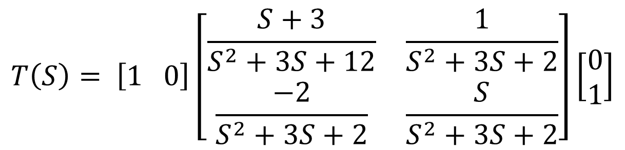
Calculation in Matlab
$$T\left(S\right)= \left[1 0\right]\left[\begin{matrix}\frac{S+3}{S^{2}+3S+12} & \frac{1}{S^{2}+3S+2} \\ \frac{−2}{S^{2}+3S+2} & \frac{S}{S^{2}+3S+2}\end{matrix}\right]\left[\begin{matrix}0 \\ 1\end{matrix}\right]$$
>> syms s
>> A = [1 0];
>> B = [((s+3)/(s^2+3*s+12)) ((1)/(s^2+3*s+2));((-2)/(s^2+3*s+2)) ((s)/(s^2+3*s+2))];
>> C=[0;1]
>> D=A*B*C
D =
1/(s^2 + 3*s + 2)

Slide 21
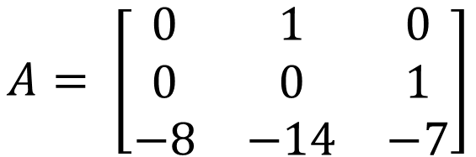
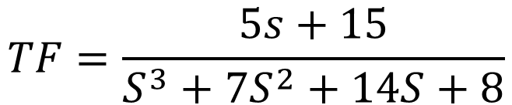


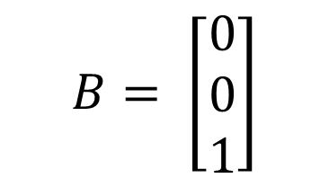
HOME WORK
$$Q1:The matrices of third−order system are given by$$
$$A= \left[\begin{matrix}0 & 1 & 0 \\ 0 & 0 & 1 \\ −8 & −14 & −7\end{matrix}\right]$$
$$B= \left[\begin{matrix}0 \\ 0 \\ 1\end{matrix}\right]$$
$$C= \left[\begin{matrix}15 & 5 & 0\end{matrix}\right]$$
$$D=0$$
>> A=[0 1;-12 -8]; >> B =[0;1]; >> C = [8 1]; >> D = 0; >> [n,d]=ss2tf(A,B,C,D); >> mySys_tf=tf(n,d)
$$TF=\frac{5s+15}{S^{3}+7S^{2}+14S+8}$$

Slide 22
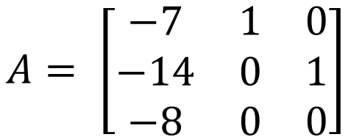
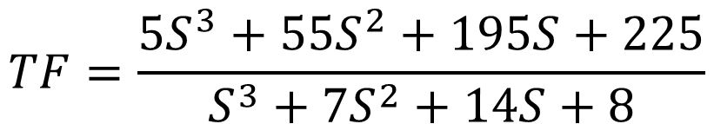


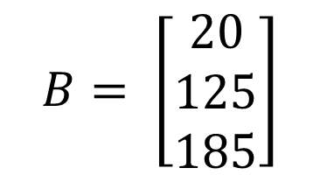
HOME WORK
$$Q2:The matrices of third−order system are given by$$
$$A= \left[\begin{matrix}−7 & 1 & 0 \\ −14 & 0 & 1 \\ −8 & 0 & 0\end{matrix}\right]$$
$$B= \left[\begin{matrix}20 \\ 125 \\ 185\end{matrix}\right]$$
$$C= \left[\begin{matrix}1 & 0 & 0\end{matrix}\right]$$
$$D=5$$
>> A=[0 1;-12 -8]; >> B =[0;1]; >> C = [8 1]; >> D = 0; >> [n,d]=ss2tf(A,B,C,D); >> mySys_tf=tf(n,d)
$$TF=\frac{5S^{3}+55S^{2}+195S+225}{S^{3}+7S^{2}+14S+8}$$

Slide 23

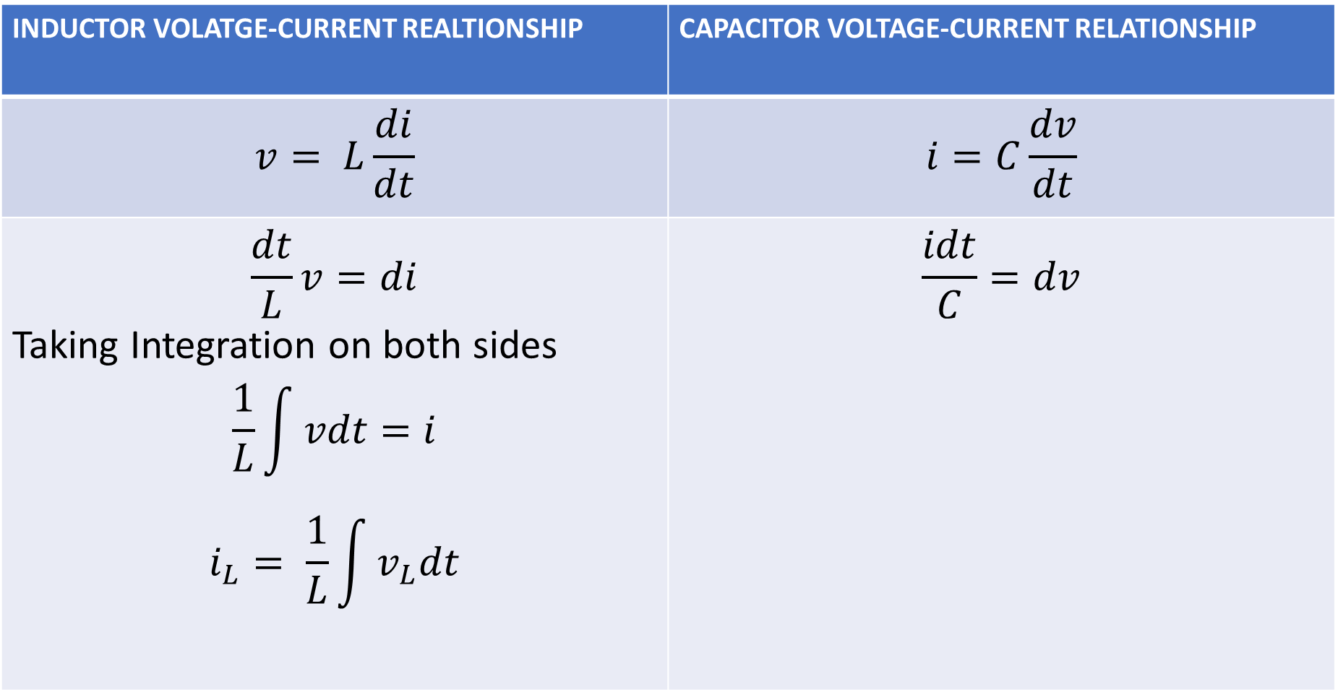

INDUCTOR VOLATGE-CURRENT REALTIONSHIP | CAPACITOR VOLTAGE-CURRENT RELATIONSHIP
$$v= L\frac{di}{dt}$$ | $$i=C\frac{dv}{dt}$$
$$\frac{dt}{L}v=di$$ Taking Integration on both sides $$\frac{1}{L}\int{vdt}=i$$ $$i_{L}= \frac{1}{L}\int{v_{L}dt}$$ | $$\frac{idt}{C}=dv$$
Taking Integration on both sides
$$\frac{1}{C}\int{idt}=v$$
OR
OR
$$v_{C}=\frac{1}{C}\int{idt}$$

Slide 24
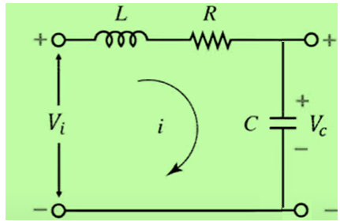
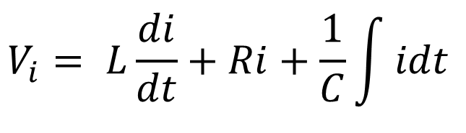
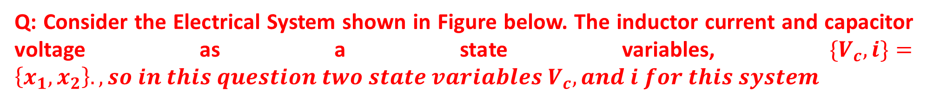
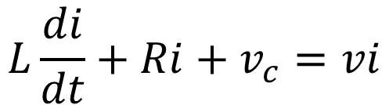

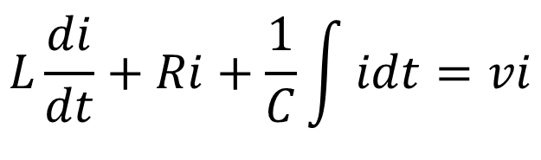
Q: Consider the Electrical System shown in Figure below. The inductor current and capacitor voltage as a state variables, ${\{V}_{c}, i\}=\left\{x_{1},x_{2}\right\}., so in this question two state variables{ V}_{c}, and i for this system$
SOLUTION
By Applying KVL, we can write equations from Input Side,
$$V_{i}= L\frac{di}{dt}+Ri+\frac{1}{C}\int{idt}$$
$$L\frac{di}{dt}+Ri+\frac{1}{C}\int{idt}=vi$$
We want to write state-space-equation, but in state-space-representation there is no integration is involved, so we replace with v_{c}
$$v_{c}=\frac{1}{C}\int{idt}$$
$$L\frac{di}{dt}+Ri+v_{c}=vi$$

Slide 25





$$L\frac{di}{dt}+Ri+v_{c}=vi$$
One thing remember, when you writing a differential equation of any system, there should be one differential term and all the variables must be an Input state variables.
Above equation satisfied these condition, such derivative available, current and voltage both are state variables are present.
$$L\frac{di}{dt}+Ri+v_{c}=vi$$
$$L\frac{di}{dt}=−Ri− v_{c}+vi$$
$$\frac{di}{dt}=−\frac{R}{L} i− {\frac{1}{L} v}_{c}+\frac{1}{L} vi (1)$$
By Applying KVL, on output side
$$i=C\frac{dV_{c}}{dt} ↔\frac{dV_{c}}{dt}=\frac{i}{C} (2)$$

Slide 26




$$\frac{di}{dt}=−\frac{R}{L} i− {\frac{1}{L} v}_{c}+\frac{1}{L} vi (1)$$
Can equation (2), satisfied conditions.
Yes it have a derivative term, and also current and voltage both state variables are present.
$$i=C\frac{dV_{c}}{dt} ↔\frac{dV_{c}}{dt}=\frac{i}{C} (2)$$
Renaming of equation for simplicity such as equation (1) as (2) and (2) as (1)
$$\frac{dV_{c}}{dt }=\frac{i}{C} (1)$$
$$\frac{di}{dt}=−\frac{R}{L} i− {\frac{1}{L} v}_{c}+\frac{1}{L} vi (2)$$

Slide 27








$$\frac{dV_{c}}{dt }=\frac{i}{C} (1)$$
$$\frac{di}{dt}=−\frac{R}{L} i− {\frac{1}{L} v}_{c}+\frac{1}{L} vi (2)$$
$$\left[\begin{matrix}\frac{dV_{c}}{dt } \\ \frac{di}{dt}\end{matrix}\right]= \left[\begin{matrix}0 & \frac{i}{C} \\ −\frac{1}{L} & −\frac{R}{L}\end{matrix}\right]\left[\begin{matrix}V_{c} \\ i\end{matrix}\right]+\left[\begin{matrix}0 \\ \frac{1}{L}\end{matrix}\right]V_{i}$$
$X^{′}$= $AX+BU (1)$
$Y$ = $CX + DU (2)$
$$\frac{d}{dt}\left[\begin{matrix}V_{c} \\ i\end{matrix}\right]= \left[\begin{matrix}0 & \frac{i}{C} \\ −\frac{1}{L} & −\frac{R}{L}\end{matrix}\right]\left[\begin{matrix}V_{c} \\ i\end{matrix}\right]+\left[\begin{matrix}0 \\ \frac{1}{L}\end{matrix}\right]V_{i}$$
$\left[\begin{matrix}x_{1}^{′} \\ x_{2}^{′}\end{matrix}\right]$ = $\left[\begin{matrix}0 & 1 \\ −2 & −3\end{matrix}\right]\left[\begin{matrix}x_{1} \\ x_{2}\end{matrix}\right]+\left[\begin{matrix}0 \\ 1\end{matrix}\right]$u
y = $\left[\begin{matrix}1 & 0\end{matrix}\right]\left[\begin{matrix}x_{1} \\ x_{2}\end{matrix}\right]$

Slide 28





Y Term we used output side of Circuit
For output equation, as capacitor voltage itself is output therefore,
$$V_{c}{= V}_{c}$$
$$V_{c}=\left[\begin{matrix}1 & 0\end{matrix}\right] \left[\begin{matrix}V_{c} \\ i\end{matrix}\right]+0$$
$X^{′}$= $AX+BU (1)$
$Y$ = $CX + DU (2)$
$\left[\begin{matrix}x_{1}^{′} \\ x_{2}^{′}\end{matrix}\right]$ = $\left[\begin{matrix}0 & 1 \\ −2 & −3\end{matrix}\right]\left[\begin{matrix}x_{1} \\ x_{2}\end{matrix}\right]+\left[\begin{matrix}0 \\ 1\end{matrix}\right]$u
y = $\left[\begin{matrix}1 & 0\end{matrix}\right]\left[\begin{matrix}x_{1} \\ x_{2}\end{matrix}\right]$

Slide 29





STATE-SPACE MODELLING OF PHYSICAL SYSTEMS (ELECTRICAL SYSTEMS)
Q: Consider the Electrical System shown in Figure below. The inductor current and capacitor voltage as a state variables, ${\{V}_{c}, i\}=\left\{x_{1},x_{2}\right\}., so in this question two state variables{ V}_{c}, and i for this system$
SOLUTION
STEP-01: Apply KVL ON INPUT SIDE
$V_{i}=V_{L}+V_{R}$+ $V_{C}$
$$V_{i}= L\frac{di}{dt}+Ri+V_{C}$$
$$L\frac{di}{dt}+Ri+V_{C}=V_{i}$$
$$L\frac{di}{dt}=−V_{C}−Ri+V_{i}$$
$$\frac{di}{dt}=−{\frac{1}{L} V}_{C}−\frac{R}{L} i+{\frac{1}{L} V}_{i} (1)$$

Slide 30



STEP-02: Apply KVL ON OUTPUT SIDE
$$i=C\frac{dV_{c}}{dt}$$
$$\frac{dV_{c}}{dt}=\frac{1}{C}i (2)$$

Slide 31







STEP-03: Convert equation (1), and (2) into state equations
$$\left[\begin{matrix}\frac{di}{dt} \\ \frac{dV_{c}}{dt}\end{matrix}\right]= \left[\begin{matrix}−\frac{R}{L} & −\frac{1}{L} \\ 0 & \frac{1}{C}\end{matrix}\right]\left[\begin{matrix}i \\ V_{c}\end{matrix}\right] +\left[\begin{matrix}\frac{1}{L} \\ 0\end{matrix}\right]V_{i}$$
$$\frac{di}{dt}=−{\frac{1}{L} V}_{C}−\frac{R}{L} i+{\frac{1}{L} V}_{i} (1)$$
$$\frac{dV_{c}}{dt}=\frac{1}{C}i (2)$$
OR ACCORDING TO BOOK, RENAME EQUATION (1) AS AN EQUATION (2) AND EQUATION (2) INTO EQUATION (1)
$$\frac{dV_{c}}{dt}=\frac{1}{C}i (1)$$
$$\left[\begin{matrix}\frac{dV_{c}}{dt} \\ \frac{di}{dt}\end{matrix}\right]= \left[\begin{matrix}0 & \frac{1}{C} \\ −\frac{1}{L} & −\frac{R}{L}\end{matrix}\right]\left[\begin{matrix}V_{c} \\ i\end{matrix}\right] +\left[\begin{matrix}0 \\ \frac{1}{L}\end{matrix}\right]V_{i}$$
$$\frac{di}{dt}=−{\frac{1}{L} V}_{C}−\frac{R}{L} i+{\frac{1}{L} V}_{i} (2)$$
$X^{′}$= $A X + B U$

Slide 32



STEP-04: Output Side
$$V_{c}= V_{c}$$
$V_{c}=\left[\begin{matrix}1 & 0\end{matrix}\right]\left[\begin{matrix}V_{c} \\ i\end{matrix}\right]$ + 0
$Y$ = $CX + DU (2)$

Slide 33










STATE-SPACE MODELLING OF PHYSICAL SYSTEMS (ELECTRICAL SYSTEMS)
EXAMPLE: Consider the Electrical system as shown in figure below. Here we will choose currents and capacitor voltage as state variables $\left\{x_{1}, x_{2}, x_{3}\right\}=\left\{V_{c}, i_{1}, i_{2}\right\}$
SOLUTION
STEP-01: Apply KVL ON INPUT SIDE
Appl KVL ON First Loop
$$V_{i}=V_{L1}+V_{R}$$
$$\frac{R}{L_{1}}i_{2}−\frac{R}{L_{1}}i_{1}+\frac{1}{L_{1}}V_{i}=\frac{di_{1}}{dt}$$
$$V_{i}=L_{1}\frac{di_{1}}{dt}+R\left(i_{1}−i_{2}\right)$$
$$−R\left(i_{1}−i_{2}\right)+V_{i}=L_{1}\frac{di_{1}}{dt}$$
$$\frac{di_{1}}{dt}=\frac{R}{L_{1}}i_{2}−\frac{R}{L_{1}}i_{1}+\frac{1}{L_{1}}V_{i}$$
$$−\frac{R}{L_{1}} \left(i_{1}−i_{2}\right)+\frac{V_{i}}{L_{1}}=\frac{di_{1}}{dt}$$
$$\frac{di_{1}}{dt}=−\frac{R}{L_{1}}i_{1}+\frac{R}{L_{1}}i_{2}+\frac{1}{L_{1}}V_{i}$$
$$−\frac{R}{L_{1}}i_{1}+\frac{R}{L_{1}}i_{2}+\frac{V_{i}}{L_{1}}=\frac{di_{1}}{dt}$$
$$\frac{di_{1}}{dt}=−\frac{R}{L_{1}}i_{1}+\frac{R}{L_{1}}i_{2}+\frac{1}{L_{1}}V_{i} (1)$$

Slide 34







Appl KVL ON Second Loop
$$0=V_{L2}+{V_{c}+ V}_{R}$$
$$0=L_{2}\frac{di_{2}}{dt}+V_{c}+R\left(i_{2}−i_{1}\right)$$
$$−R\left(i_{2}−i_{1}\right){−V}_{c}=L_{2}\frac{di_{2}}{dt}$$
$$−\frac{R}{L_{2}} \left(i_{2}−i_{1}\right)−\frac{V_{c}}{L_{2}}=\frac{di_{2}}{dt}$$
$$−\frac{R}{L_{2}}i_{2}+\frac{R}{L_{2}}i_{1}−\frac{V_{c}}{L_{2}}=\frac{di_{2}}{dt}$$
$$\frac{R}{L_{2}}i_{1}−\frac{R}{L_{2}}i_{2}−\frac{1}{L_{2}}V_{c}=\frac{di_{2}}{dt}$$
$$\frac{di_{2}}{dt}=\frac{R}{L_{2}}i_{1}−\frac{R}{L_{2}}i_{2}−\frac{1}{L_{2}}V_{c} (2)$$

Slide 35




STEP-02: Apply KVL ON OUTPUT SIDE
$$\frac{i_{2}dt}{C}=dV_{C}$$
$$i_{2}=C\frac{dV_{C}}{dt}$$
$${\frac{1}{C} i}_{2}=\frac{dV_{C}}{dt}$$
$$\frac{dV_{C}}{dt}={\frac{1}{C} i}_{2} (3)$$

Slide 36







STEP-03: Convert equation (1), (2), and (3) into state equations
$$\left[\begin{matrix}\frac{di_{1}}{dt} \\ \frac{di_{2}}{dt} \\ \frac{dV_{C}}{dt}\end{matrix}\right]= \left[\begin{matrix}−\frac{R}{L_{1}} & \frac{R}{L_{2}} & 0 \\ \frac{R}{L_{2}} & −\frac{R}{L_{2}} & −\frac{1}{L_{2}} \\ 0 & \frac{1}{C} & 0\end{matrix}\right]\left[\begin{matrix}i_{1} \\ i_{2} \\ V_{c}\end{matrix}\right]+\left[\begin{matrix}\frac{1}{L_{1}} \\ 0 \\ 0\end{matrix}\right]V_{i}$$
$$\frac{di_{1}}{dt}=−\frac{R}{L_{1}}i_{1}+\frac{R}{L_{1}}i_{2}+\frac{1}{L_{1}}V_{i} (1)$$
$$\frac{di_{2}}{dt}=\frac{R}{L_{2}}i_{1}−\frac{R}{L_{2}}i_{2}−\frac{1}{L_{2}}V_{c} (2)$$
$$\frac{dV_{C}}{dt}={\frac{1}{C} i}_{2} (3)$$
$$\left[\begin{matrix}\frac{di_{1}}{dt} \\ \frac{di_{2}}{dt} \\ \frac{dV_{C}}{dt}\end{matrix}\right]=\left[\begin{matrix}−\frac{R}{L_{1}} & \frac{R}{L_{2}} & 0 \\ \frac{R}{L_{2}} & −\frac{R}{L_{2}} & −\frac{1}{L_{2}} \\ 0 & \frac{1}{C} & 0\end{matrix}\right]\left[\begin{matrix}i_{1} \\ i_{2} \\ V_{c}\end{matrix}\right]+\left[\begin{matrix}\frac{1}{L_{1}} \\ 0 \\ 0\end{matrix}\right]V_{i}$$
$X^{′}$= $AX + BU (1)$
$Y$ = $CX + DU (2)$

Slide 37

STEP-04: Output Side
$$V_{c}= V_{c}$$
$V_{c}=\left[\begin{matrix}0 & 0 & 1\end{matrix}\right]\left[\begin{matrix}i_{1} \\ i_{2} \\ V_{c}\end{matrix}\right]$ + 0
$Y$ = $CX + DU (2)$

